Slide 1
THE LIFE OF CHRIST
PART 35

Slide 2
Luke 8:1 Now it came to pass, afterward, that He went through every city and village, preaching and bringing the glad tidings of the kingdom of God. And the twelve were with Him, ² and certain women who had been healed of evil spirits and infirmities -- Mary called Magdalene, out of whom had come seven demons, ³ and Joanna the wife of Chuza, Herod's steward, and Susanna, and many others who provided for Him from their substance.

Slide 3
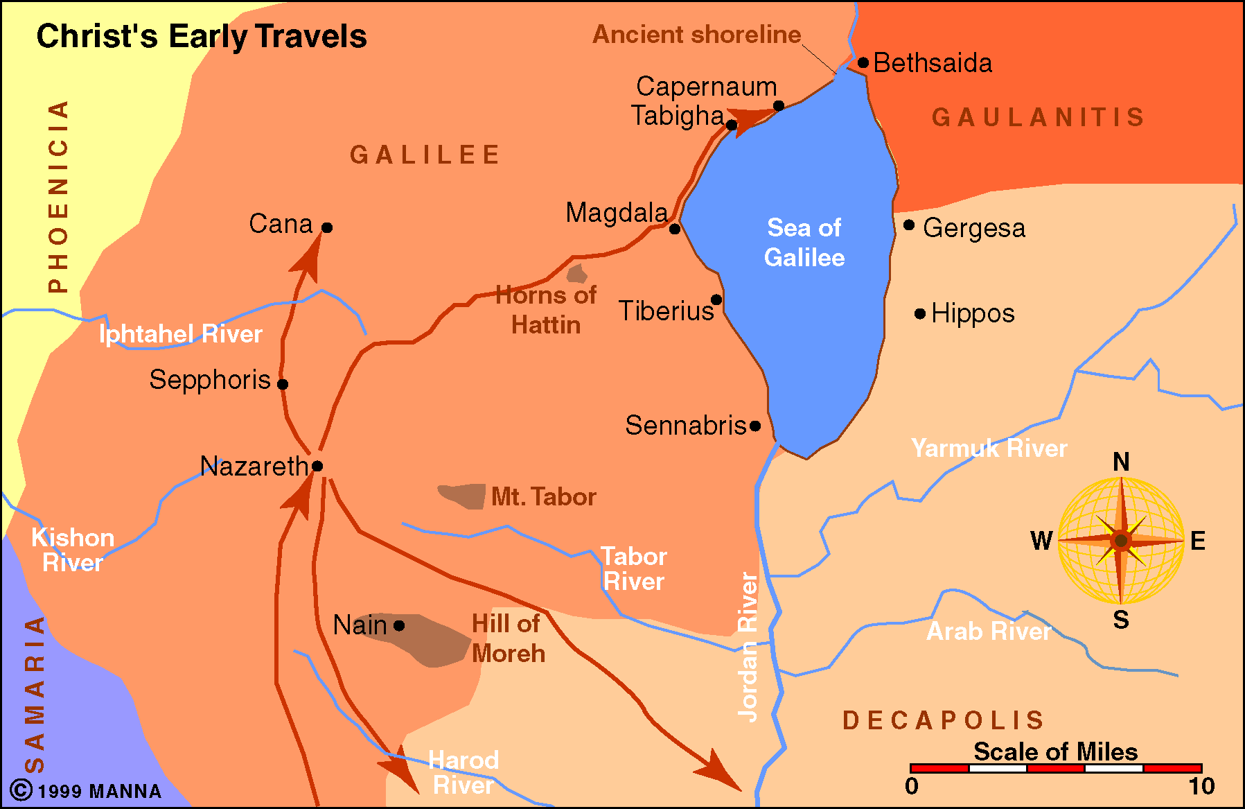

Slide 4
Mark 3:20 Then the multitude came together again, so that they could not so much as eat bread. ²¹ But when His own people heard about this, they went out to lay hold of Him, for they said, "He is out of His mind."

Slide 5
Matthew 12:22 Then one was brought to Him who was demon-possessed, blind and mute; and He healed him, so that the blind and mute man both spoke and saw. ²³ And all the multitudes were amazed and said, "Could this be the Son of David?" ²⁴ Now when the Pharisees heard it they said, "This fellow does not cast out demons except by Beelzebub, the ruler of the demons."

Slide 6
Easton Bible dictionary defines Beelzebub:
499 Beelzebub the name given to Satan, and found only in the New Testament Mt 10:25 12:24,27 Mr 3:22 It is probably the same as Baalzebub (q.v.), the god of Ekron, meaning "the lord of flies," or, as others think, "the lord of dung," or "the dung-god."

Slide 7
Luke 11:16 Others, testing Him, sought from Him a sign from heaven.

Slide 8
Luke 11:17 But He, knowing their thoughts, said to them: "Every kingdom divided against itself is brought to desolation, and a house divided against a house falls. ¹⁸ "If Satan also is divided against himself, how will his kingdom stand? Because you say I cast out demons by Beelzebub. ¹⁹ "And if I cast out demons by Beelzebub, by whom do your sons cast them out? Therefore they will be your judges. ²⁰ "But if I cast out demons with the finger of God, surely the kingdom of God has come upon you.

Slide 9
Acts 19:13 Then some of the itinerant Jewish exorcists took it upon themselves to call the name of the Lord Jesus over those who had evil spirits, saying, "We exorcise you by the Jesus whom Paul preaches." ¹⁴ Also there were seven sons of Sceva, a Jewish chief priest, who did so. ¹⁵ And the evil spirit answered and said, "Jesus I know, and Paul I know; but who are you?" ¹⁶ Then the man in whom the evil spirit was leaped on them, overpowered them, and prevailed against them, so that they fled out of that house naked and wounded.

Slide 10
Luke 11:21"When a strong man, fully armed, guards his own palace, his goods are in peace. ²² "But when a stronger than he comes upon him and overcomes him, he takes from him all his armor in which he trusted, and divides his spoils. ²³ "He who is not with Me is against Me, and he who does not gather with Me scatters.

Slide 11
Matthew 12:31 " Therefore I say to you, every sin and blasphemy will be forgiven men, but the blasphemy against the Spirit will not be forgiven men. ³² "Anyone who speaks a word against the Son of Man, it will be forgiven him; but whoever speaks against the Holy Spirit, it will not be forgiven him, either in this age or in the age to come.

Slide 12
“Blasphemy against the Holy Spirit (Mk. 12:31-32) is an unpardonable sin, but so is every sin unrepented of.” (Guy N. Woods Questions and answers).

Slide 13
The sin against the Holy Spirit (Mt. 12:31-32), is, in principle, the rejection of the revelation which the Spirit, the third person of the Godhead, made, first through our Lord, and then through His representatives. It is the denial of the Spirit’s message initially, by direct inspiration, and then through the Book, the practical effects of which is the rejection of the Deity of our Lord, the repudiation of His sacrificial death, the annulment of the Atonement, and the implication that a sacrifice with be made.

Slide 14
Those who thus do would crucify Christ “afresh,” from the allegation that He who died on the cross was an imposter and that the suffering Savior must yet appear, and suffer. Salvation is denied those of this category, not because it is not offered to them, but because they have permanently rejected it. (Heb. 6:1ff; 10:25-28). The ever-flowing waters of the Well of life are always available to those who desire to come and to quench their thirst. (Guy N. Woods Questions and answers).

Slide 15
What is the sin, then, against the Holy Spirit? Many think these people committed that sin. But did they speak against Christ or against the Holy Spirit? Clearly, against Christ; Jesus , as we understand it, told them, In this you speak against me. For this, there is a chance for forgiveness. But when the Holy Spirit is come, if you speak against Him, if you reject Him, as you know reject me, there will then be no forgiveness. It was a warning, given on the occasion of their speaking against Him, that they cannot so treat the Holy Spirit when He shall come, and find forgiveness.

Slide 16
The reason is, they speak against Christ during His life, and when the Holy Spirit shall come, He will give additional evidence that Jesus is the Son of God, and opportunities to hear God and return. But when the Spirit shall come and given His testimonies and revelations, the testimony will be complete , and he who rejects that will have nothing more to move him to repentance. (C.E.W. Dorris Commentary on Mark).

Slide 17
Matthew 12:33 " Either make the tree good and its fruit good, or else make the tree bad and its fruit bad; for a tree is known by its fruit. ³⁴ "Brood of vipers! How can you, being evil, speak good things? For out of the abundance of the heart the mouth speaks. ³⁵ "A good man out of the good treasure of his heart brings forth good things, and an evil man out of the evil treasure brings forth evil things. ³⁶ "But I say to you that for every idle word men may speak, they will give account of it in the day of judgment. ³⁷ "For by your words you will be justified, and by your words you will be condemned."

Slide 18
Matthew 12:38 Then some of the scribes and Pharisees answered, saying, "Teacher, we want to see a sign from You." ³⁹ But He answered and said to them, "An evil and adulterous generation seeks after a sign, and no sign will be given to it except the sign of the prophet Jonah. ⁴⁰ "For as Jonah was three days and three nights in the belly of the great fish, so will the Son of Man be three days and three nights in the heart of the earth. ⁴¹ "The men of Nineveh will rise up in the judgment with this generation and condemn it, because they repented at the preaching of Jonah; and indeed a greater than Jonah is here.

Slide 19
⁴² "The queen of the South will rise up in the judgment with this generation and condemn it, for she came from the ends of the earth to hear the wisdom of Solomon; and indeed a greater than Solomon is here.

Slide 20
Matthew 12:43 " When an unclean spirit goes out of a man, he goes through dry places, seeking rest, and finds none. ⁴⁴ "Then he says, 'I will return to my house from which I came.' And when he comes, he finds it empty, swept, and put in order. ⁴⁵ "Then he goes and takes with him seven other spirits more wicked than himself, and they enter and dwell there; and the last state of that man is worse than the first. So shall it also be with this wicked generation."

Slide 21
This parable of a wandering demon applies to the Jewish nation, which is "the man." The "going out" represents the spiritual rebirth of Israel under the preaching of John the Baptist. The "swept and garnished" period (in next verse) referred to the lack of any meaningful change in the character of the people, and the relatively innocuous neglect of Christ during the early part of his ministry. The restlessness of the demon showed the anxious and unrelenting hostility of the forces of evil and their determination against Christ.

Slide 22
2 Peter 2:20 For if, after they have escaped the pollutions of the world through the knowledge of the Lord and Savior Jesus Christ, they are again entangled in them and overcome, the latter end is worse for them than the beginning.

Slide 23
Matthew 12:46 While He was still talking to the multitudes, behold, His mother and brothers stood outside, seeking to speak with Him. ⁴⁷ Then one said to Him, "Look, Your mother and Your brothers are standing outside, seeking to speak with You." ⁴⁸ But He answered and said to the one who told Him, "Who is My mother and who are My brothers?" ⁴⁹ And He stretched out His hand toward His disciples and said, "Here are My mother and My brothers! ⁵⁰ "For whoever does the will of My Father in heaven is My brother and sister and mother."

Slide 24
Matthew 10:37 "He who loves father or mother more than Me is not worthy of Me. And he who loves son or daughter more than Me is not worthy of Me. ³⁸ "And he who does not take his cross and follow after Me is not worthy of Me.

Slide 25
Matthew 1:24 Then Joseph, being aroused from sleep, did as the angel of the Lord commanded him and took to him his wife, ²⁵ and did not know her till she had brought forth her firstborn Son. And he called His name JESUS.

